Slide 1
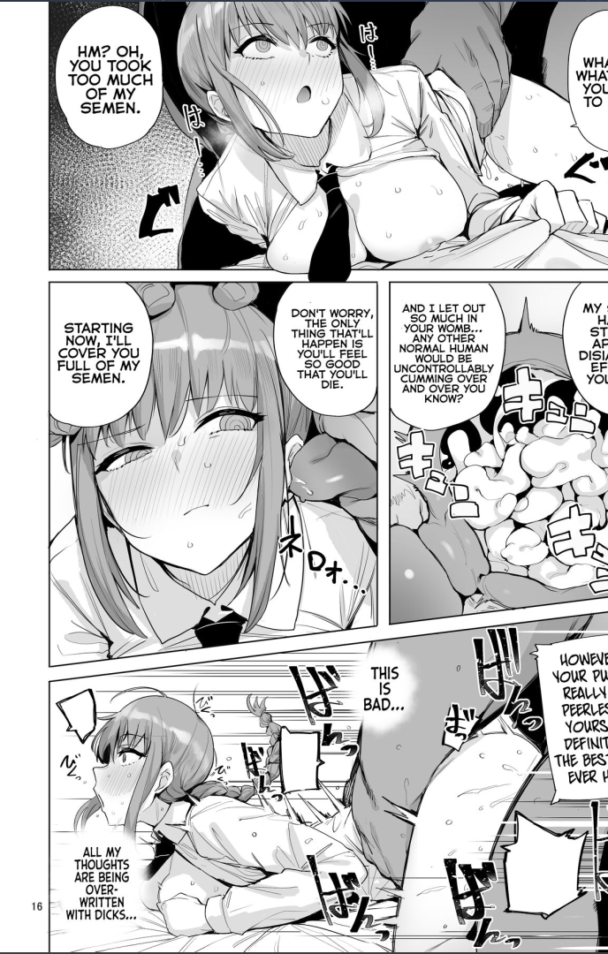
Belajar aja cuy
GeneralNoeh

Slide 2
Makima
Cantik beut makima

Slide 3
kyaa
Waifu gw

Slide 4
Apas ih ngab
awokawokw

Slide 5
makima
🥵🥵🥵🥵🥵🥵❤️❤️❤️

